Slide 1
Selected-2
project
Team No. 16

Slide 2
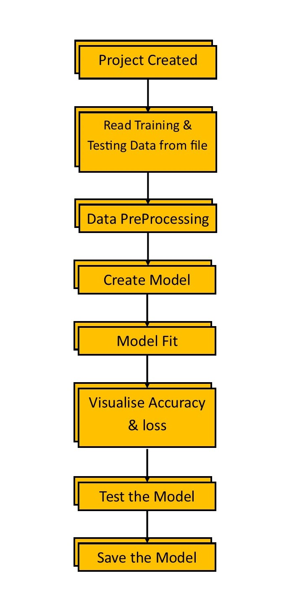

Introduction
This project is about how to recognize Arabic HandWritten characters using Deep Learning

Slide 3
Data preprocessing
Preparing Data

Slide 4
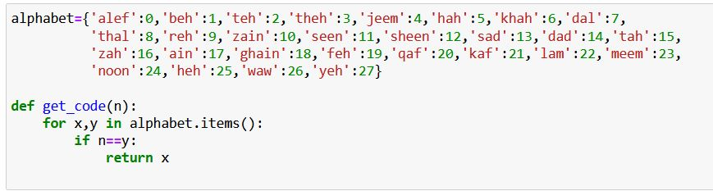
Dataset
Some modification on dataset such as split images to classes and get_code Function that return class name

Slide 5
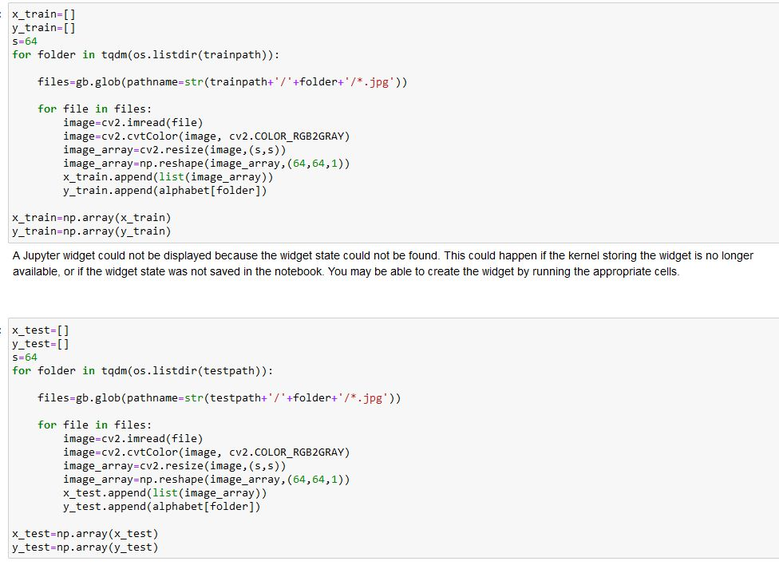
Dataset
CONT.
Read Training & Testing images

Slide 6
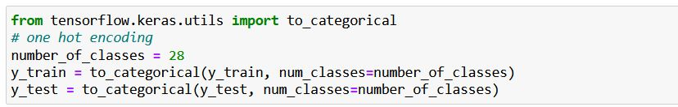
Dataset
CONT.
Data normalization
Convert Train & Test lables to one hot encoding
Split Train array to Train & validation

Slide 7
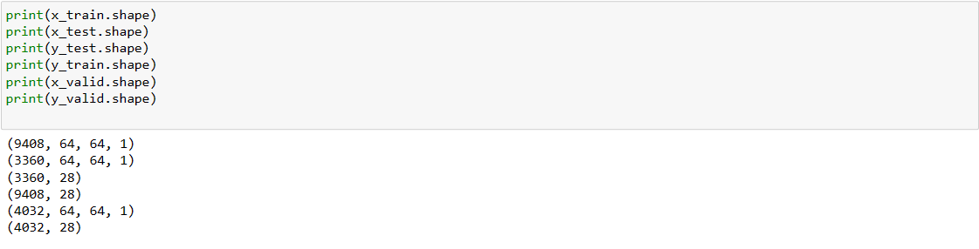
Dataset
CONT.
Shape of Train & Test & Validtion

Slide 8
Modeling
CNN Model

Slide 9
CNN Model
Model Function that contain (4 convolutional layer & 4 Batch Normlization Layer & 4 dropout Layer & 4 MaxPooling Layer & 1 AveragePooling Layer & 1 Dense Layer )
The activation function Used (ReLU)
The Optemizer (adam)
The Kernel_initializer (he_normal)

Slide 10
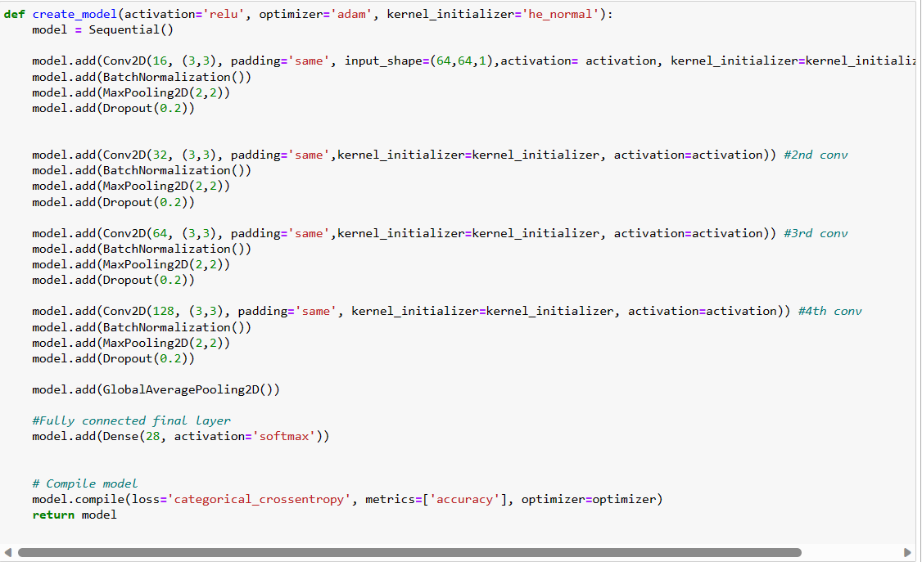
CNN Model
CONT.

Slide 11
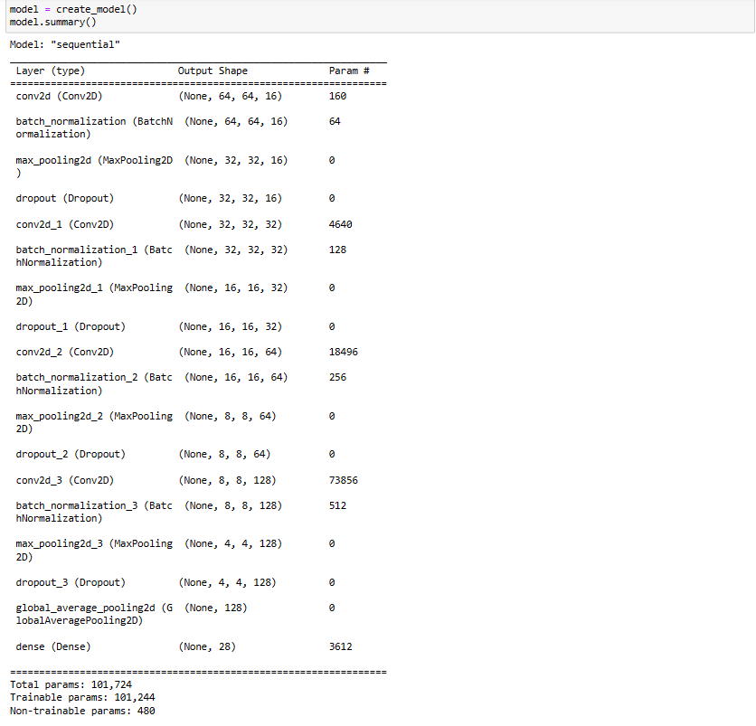
CNN Model
CONT.
Summary of Model

Slide 12
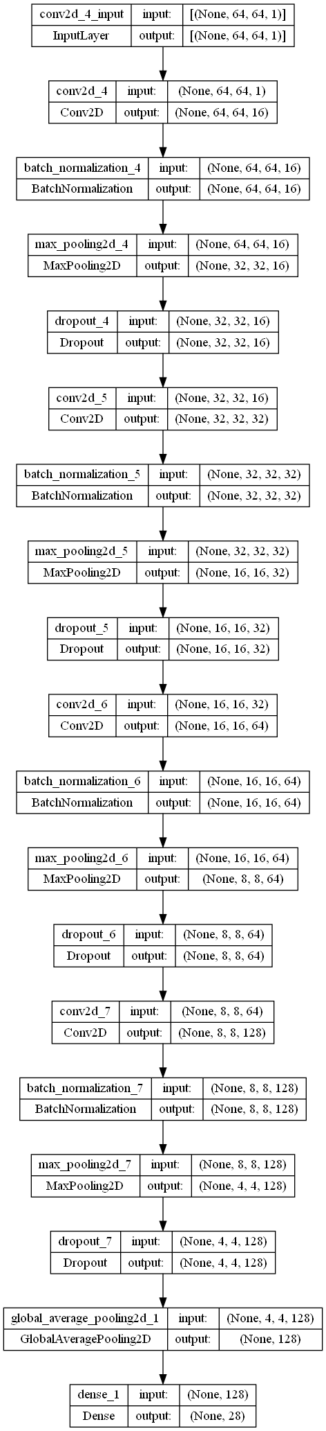
CNN Model
CONT.
Plot model

Slide 13
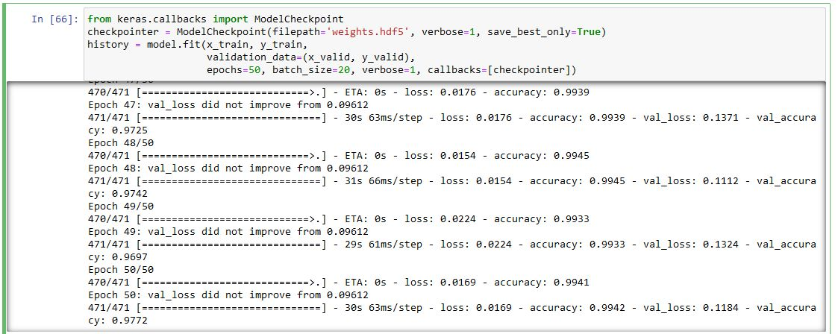
CNN Model
CONT.
Model Fitting

Slide 14
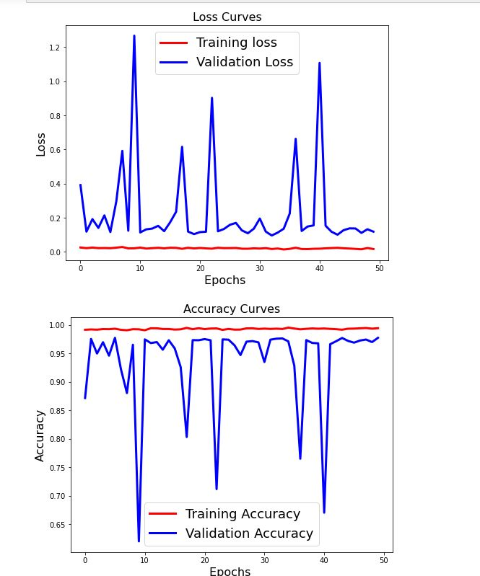
CNN Model
CONT.
Loss & Accuracy Curves

Slide 15
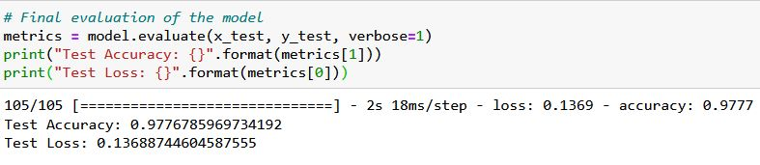
CNN Model
CONT.
Test Accuracy

Slide 16
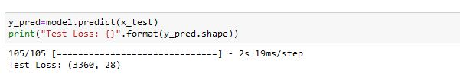
CNN Model
CONT.
Image Prediction

Slide 17
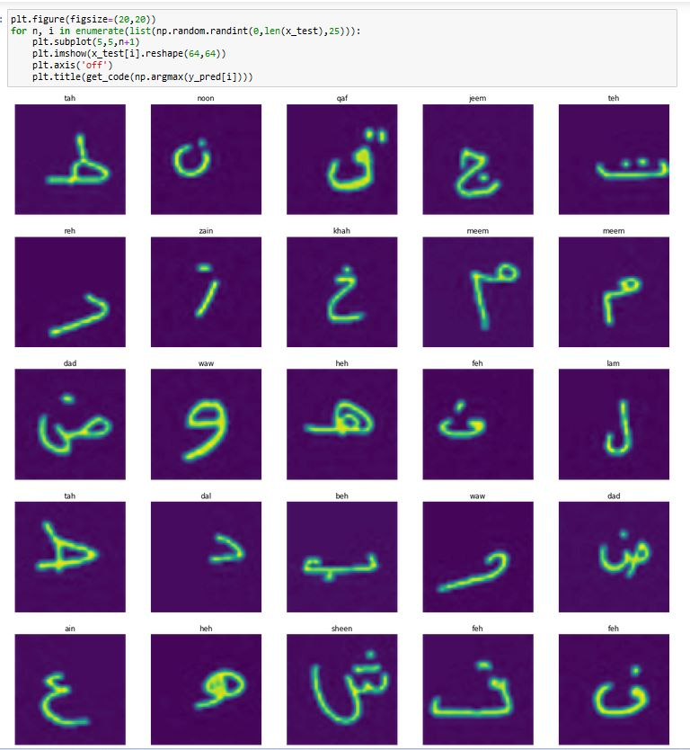
CNN Model
CONT.
Image Prediction

Slide 18
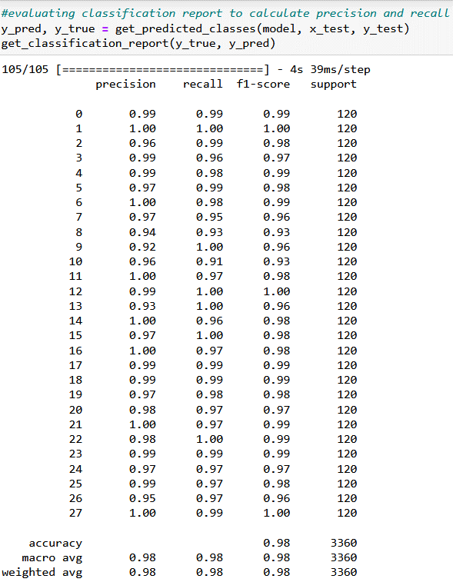
CNN Model
CONT.
Calculate precision and recall ,F1_score by using Classification report.

Slide 19

Thank you
TEAM GAMED

